Slide 1


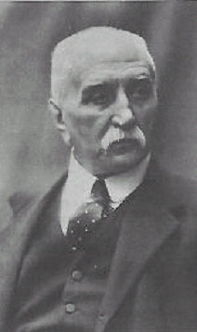















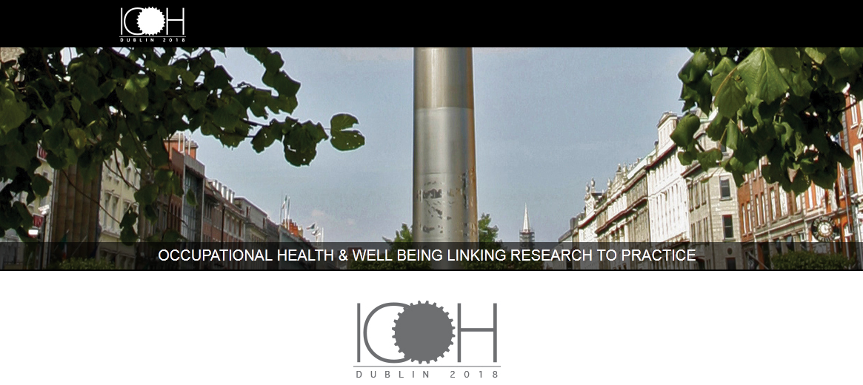

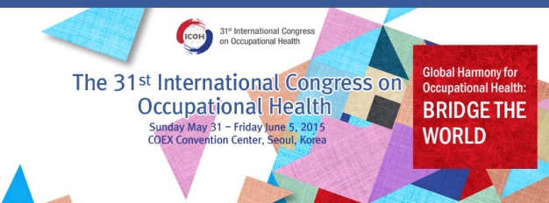






























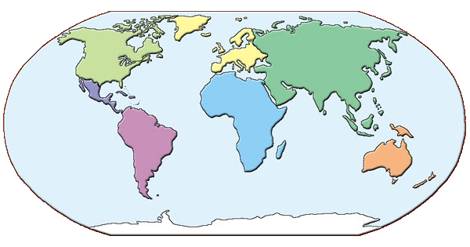
About ICOH
2021 Melbourne
1906 Milan
2015
Seoul
2021 Melbourne
1906 Milan
2015
Seoul
2018 Dublin
2012
Cancun
2018 Dublin
1910
Brussels
2009
Cape Town
1925
Amsterdam
37 Scientific Committees
2006
Milan
SUSTANING MEMBERS
PARTNERS
2003
Iguassu Falls
AFFILIATE MEMBERS
1928
Budapest
RESEARCH
COLLABORATION WITH INTERNATIONAL NGO’s
2000
Singapore
1931
Geneva
1996
Stockholm
The International Commission on Occupational Health (ICOH) is an international non-governmental professional society whose aims are to foster the scientific progress, knowledge and development of occupational health and safety in all its aspects.
1935
Brussels
GOOD PRACTICES
More than 2,000 professionals from 93 countries,
57 National Secretaries
1993
Nice
1938
Frankfurt
1990
Montreal
1948
London
1987
Sydney
PUBLICATIONS
1951
Lisbon
1984
Dublin
1954
Naples
1981
Cairo
1957
Helsinki
1978
Dubrovnik
1960
New York
1975
Brighton
1972
Buenos Aires
1969
Tokyo
1966
Vienna
1963
Madrid

